Slide 1
SueC – an editor and interpreter for pseudocode
Student: Mihai PÎȚU
Supervisor: Assoc. Prof. Dr. Eng. Emil Ștefan Chifu

Slide 2
Content
Introduction
Motivation
Theoretical Foundation
Implementation and Design
Personal Contribution
Conclusion
Bibliography

Slide 3
Introduction
Computer science is taught in schools in Romania ~30 years, starting with 5th/9th grade.
Teachers use pseudocode for explaining algorithms and basic concepts – close to natural language.
Working on laboratories, C/C++/Pascal was used for writing code based on the pseudocode.

Slide 4
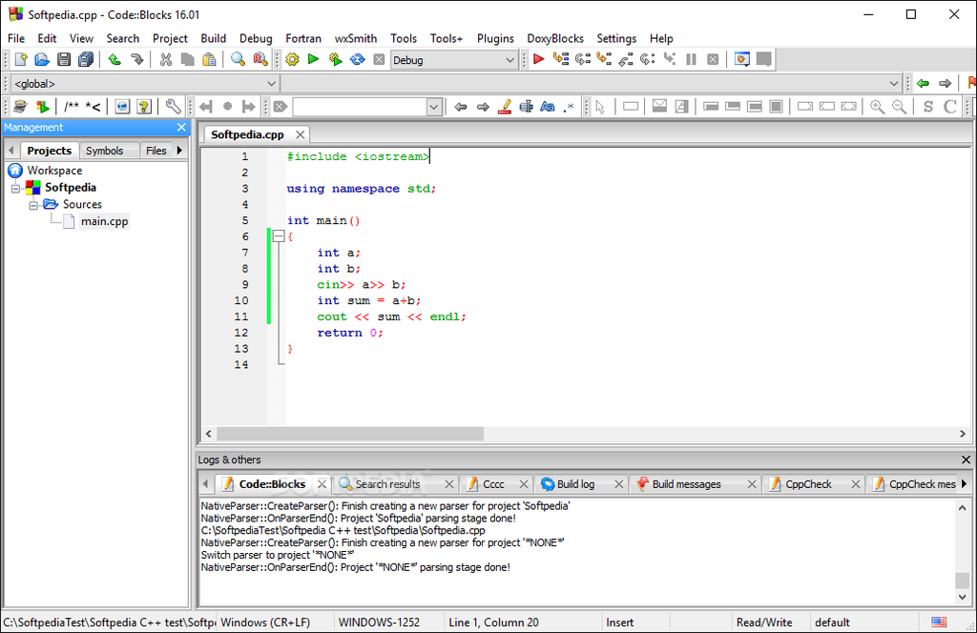
Borland C++ [1]
Code :: Blocks [2]

Slide 5
Motivation
Helping students to understand programming concepts with a user friendly editor and easy to learn programming language.
Dabbling with tutorials and educational apps – since recent events.

Slide 6
Thesis Project
Purpose
Develop an application used by anyone new to programming to edit and compile pseudocode.
Objectives
Develop a user-friendly editor.
Create a programming language similar to pseudocode.

Slide 7
Theoretical Foundation
Interpreter
Lexical Analyzer
Syntactic Analyzer
Tree Parser

Slide 8
Interpreter
A computer program that directly executes instructions written in a programming language – no need for a machine code to compile.
Historically, Lisp had the first interpreter, but there are interpreters written and run alongside compilers (e.g. for Fortran, Cobol, C).
Strategies for program execution:
Parsing the code and perform its behavior directly
Translating the code into an effiicient intermediate state and execute that state.

Slide 9
Source Code
Lexical Analyzer
Syntactic Analyzer
instructions
tokens
Tree Nodes
Output Result
Tree Parser

Slide 10
Lexical Analyzer [5]
A computer program that is designed to parse the source code into manageable tokens.
Contains a series of rules defined as regular expressions
A specific word/sentence (e.g. “int”, “do while” etc.)
A set of symbols (e.g. “[0-9]+”)
All the rules return tokens (optionally, adding raw data) – sent to the syntactic analyzer

Slide 11
Syntactic Analyzer [5]
Computer program that defines the “grammar” of a programming language.
Contains rules defined with tokens:
Internal tokens(denoted with lowercase letters) – non-terminals
External tokens(denoted with uppercase letters) – terminals – from lexical analyzer
These rules can return
The result directly
A tree node with the operation

Slide 12
Tree Parser
A program that parses a syntax tree generated from the syntactic analyzer.
Syntax tree = representation of the statements as a tree
A node is defined as having a type value, operation and (sometimes) the raw data associated
Two ways of parsing the tree[3]
Top-down parsing – “primordial soup” approach; searching the parse tree top-down(from the highest level), rewriting the rules of the formal grammar (a prefix search)
Bottom-up parsing – starting from the lowest level (leaves of the tree) and build the result, finishing with root node (postfix search)

Slide 13
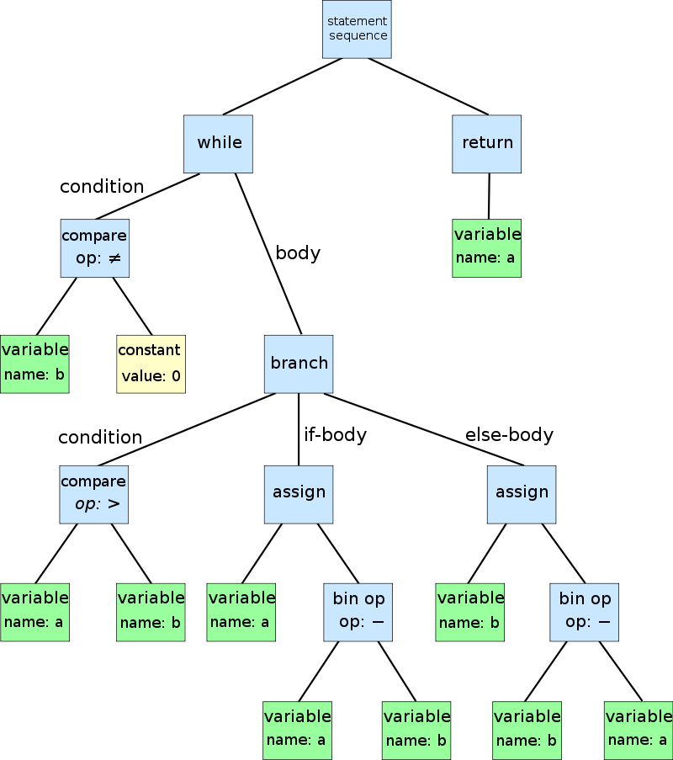
Syntax tree - example
Euclidean algorithm representation for the code:
while b!=0
if a>b
a=a-b
else
b=b-a
return a
Abstract Syntax Tree [4]

Slide 14
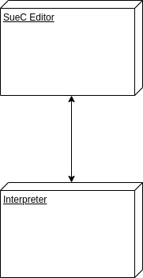
Implementation and Design
Project is split in two main components
SueC Editor Application – Java Desktop Application
Interpreter – A C Executable program accessed by the editor

Slide 15
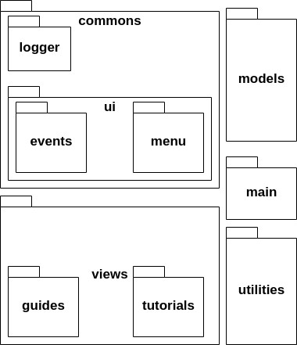
Editor Application
Java Swing Desktop Application
Adapted structure of Model-View-Controller (MVC) Pattern
models & views defined directly
controller defined internally in the views – Swing structure
Loose coupling – few methods used specific classes for grouping the operations
High cohesion – classes are defined for specific tasks that are not performed in other classes

Slide 16
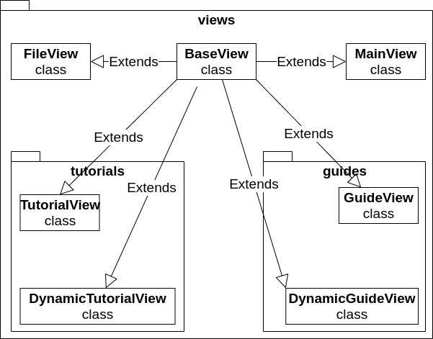
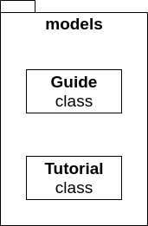
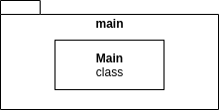
Editor Application – main, models, views class diagram

Slide 17
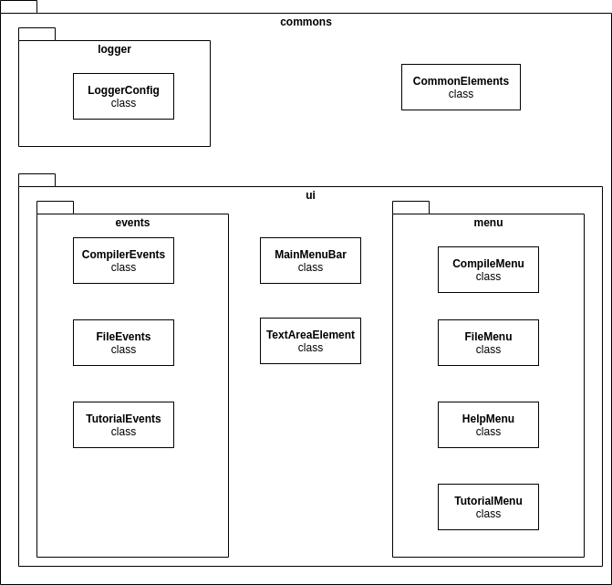
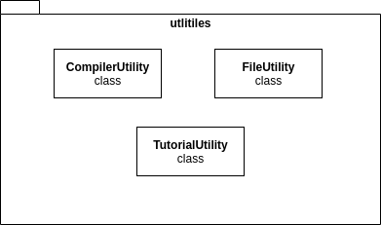
Editor Application – commons, utilities class diagram

Slide 18
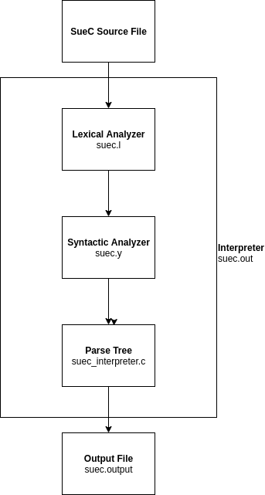
Interpreter
Executable C program that contains the definition of the rules of the programming language
Lexical analyzer – Lex source file
Syntactic analyzer – Yacc source file
Tree Parser – contains the parsing method and definition of the nodes
constNodeType for constants
idNodeType for identifiers
operNodeType for operators

Slide 19
Programming Language – pseudocode(SueC)
Similar structures as in C/C++ and Python
Close to the natural language and pseudocode
Example:
write “Hello”;
int a;
a = 5;
write a*2 ;

Slide 20
Personal Contribution
Designing the programming language’s interpreter based on a template ([6]) and laboratory work done at FLT and TD laboratories
Designing and implementing the editor application to access the interpreter
Implementing tutorial and guide menus and operations for learning to implement the programming language

Slide 21
Conclusion
Upon following all the required stages for this project: choosing the theme, documenting, implementing, designing, testing and bug-fixing, I have created a functional application that:
Contains an interpreter designed for pseudocode
Creates, edits and saves SueC source code files than can be compiled in the editor
Contains tutorials and guides for learning the SueC programming language

Slide 22
Further developments
Editor Application
Support for cross-platform (currently working only on Linux systems)
Adding more tutorials & guides
Programming language
Support for arrays and matrices
Support for floating point data types

Slide 23
Bibliography
[1] Borland C++, [Online]. Available: https://winworldpc.com/product/borland-c/30
[2] Code::Blocks, [Online]. Available: https://en.wikipedia.org/wiki/Code::Blocks
[3] Parsing – Types of parsers, [Online]. Available: https://en.wikipedia.org/wiki/Parsing#Types_of_parsers
[4] Abstract Syntax Tree, [Online]. Available: https://en.wikipedia.org/wiki/Abstract_syntax_tree
[5] Lex – A Lexical Anaylzer Generator, M.E. Lesk and E. Schmidt, [Online]. Available: https://wolfram.schneider.org/bsd/7thEdManVol2/lex/lex.pdf
[6] Lex & Yac Tutorial, Tom Niemann, [Online]. Available: https://cse.iitkgp.ac.in/~bivasm/notes/LexAndYaccTutorial.pdf

Slide 24
Thank you for your attention!

